Slide 1


cloud.iO Presentation
Lucas Bonvin

Slide 2
Why cloud.iO?

Slide 3
Motivation for cloud.iO
Realtime Monitoring
Our problems:
Each time a new solution for similar problems is developed.
There is not that much budget to create a stable/flexible solution. Data of different
projects are not simple to compare and may have to be converted first.
Monitoring is mostly very inefficient (Database Polling for example)
Data Analysis
My Solution
Data Analysis
Colleague A Solution
Realtime Monitoring
Data Analysis
Colleague B Solution

Slide 4
SCADA
Automation
Health
Supervision
Internet
of
Things
Social
Data
Exploration
Scientific
Data Acquisition
Data
Analysis
Building
Control

Slide 5

cloud.iO environment
Endpoint
Endpoint
Endpoint

Slide 6







cloud.iO features
Device Monitoring
Endpoint Library
Open Source
On-premise
Deployment
RESTful API
W3C
Compatible
Logging
Remote jobs Execution

Slide 7
cloud.iO Architecture

Slide 8




cloud.iO components
Spring.io
Micro-service Platform
Open source
RabbitMQ
Message Broker
Support AMQP and MQTT
Open source
MQTT
Messaging protocol
Support TLS/SSL
Authentication using x509 certificate
MongoDB and InfluxDB
DataBase
Free Software

Slide 9

Overview
RabbitMQ
MQTT publish/subscribe
AMQP
Message broker
Microservices
AMQP
Backends
REST Controller
HTTP &
REST API
MQTT
publish/subscribe
Endpoints
User

Slide 10
Backends
Authentication / Permission
Endpoint Repository
History Repository
Logs Repository
MongoDB
Backend
InfluxDB
Backend

Slide 11
Endpoint structure
MQTT
Endpoint
bc0f1bf8-bdae-11e9-9cb5-2a2ae2dbcce4
*
Node
bc0f1bf8-bdae-11e9-9cb5-2a2ae2dbcce4/myHeater
*
Object
*
bc0f1bf8-bdae-11e9-9cb5-2a2ae2dbcce4/myHeater/temperatures
*
Attribute
bc0f1bf8-bdae-11e9-9cb5-2a2ae2dbcce4/myHeater/temperatures/temperature

Slide 12
Topic / Json Object model
EndpointUUID: bc0f1bf8-bdae-11e9-9cb5-2a2ae2dbcce4
EndpointUUID
Topic: @update/ bc0f1bf8-bdae-11e9-9cb5-2a2ae2dbcce4 /myHeater/temperatures/temperature
{
„type“: „Number“,
„constraint“: „Measure“,
„timestamp“:1575547591859.0,
„value“: 25
}
myHeater
tempera-tures
setPoint-Tempera-ture
tempera-ture

Slide 13
Topic / Json Object model
EndpointUUID: bc0f1bf8-bdae-11e9-9cb5-2a2ae2dbcce4
{
"endpointUuid": "bc0f1bf8-bdae-11e9-9cb5-2a2ae2dbcce4",
"friendlyName": "test",
"logLevel": "ERROR",
"online": false
"blocked": false,
"endpoint": {
"nodes": {
"myHeater": {
"implements": [],
"objects": {
"temperatures": {
"attributes": {
"setPointTemperature": {
"constraint": "SetPoint",
"timestamp": -1.0,
"type": "Number",
"value": 21.0
},
"temperature": {
"constraint": "Measure",
"timestamp": 1575547591858.0,
"type": "Number",
"value": 25.000000762939507
}
},
"conforms": null,
"objects": {}
}
}
}
}
}
}
Topic: @update/ bc0f1bf8-bdae-11e9-9cb5-2a2ae2dbcce4 /myHeater/temperatures/temperature
{
„type“: „Number“,
„constraint“: „Measure“,
„timestamp“:1575547591859.0,
„value“: 25
}

Slide 14
cloud.iO Features

Slide 15
Device Monitoring
Device Twin
Available through RESTful API
Access Control
Manage through RESTful API
Control who can access cloud.iO resources (From Endpoint to Attribute)
Local Endpoint database
Locally saves messages not sent if the connection is lost
History
Available through RESTful API
Grafana plugin using RESTful API in early development at the HEVs
update
set
Endpoint

Slide 16
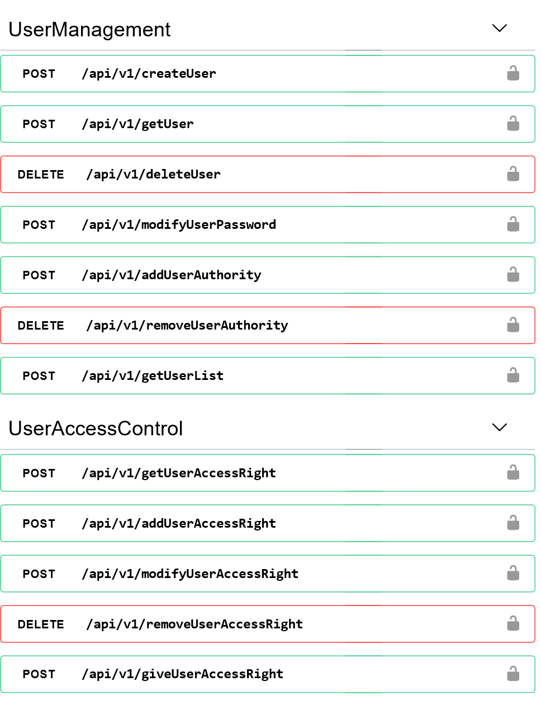
RESTful API
Http tools
User authentication
Support Https
Tools for User and Administrator
User & User Group Management
Endpoint Management
Certificate
History
Logging
Remote Jobs Execution
…

Slide 17
Logging
Logging
Saved as time-series
Possibility to filter by log level
Retrieve through RESTful API
Different log level
OFF
FATAL
ERROR
WARN
INFO
DEBUG
TRACE
ALL
!
Endpoint

Slide 18
Remote Jobs Execution
Remote Jobs Execution
Execute Shell script remotely
Execution launched with MQTT or RESTful API
Possibility to retrieve output of script
Pre-implemented command
Listing all available commands/scripts
Update Scripts from an URL
Execute script.sh
script.sh
#!/bin/sh
echo Hello world !
Endpoint

Slide 19
Remote Jobs Execution
Remote Jobs Execution
Execute Shell script remotely
Execution launched with MQTT or RESTful API
Possibility to retrieve output of script
Pre-implemented command
Listing all available commands/scripts
Update Scripts from an URL
script.sh
#!/bin/sh
echo Hello world !
Output: Hello world!
Hello
world !
Endpoint

Slide 20
W3C compatibility
World Wide Web Consortium (W3C)
Standardization organism
Behind HTLM, RDF, CSS, PNG, SVG….
Standardization of the IoT
Web Of Thing (WoT)
Candidate Recommendation
Enhance IoT Interoperability
Define a data model for the Things :TD
TD contain a self-describing API
Thing
WoT Servient
Interact
Expose
TD Consumer
Consume
Application
WoT Servient

Slide 21
Endpoint Library
Java Example of simple Heater System
Java
Device Monitoring
Logging
Remote Job Execution
Python (early development)
Device Monitoring
More language to come
public class Application {
CloudioEndpoint myEndpoint;
DemoHeater demoHeater;
static Logger logger = LogManager.getLogger(Application.class);
public static void main(String[] args) {
try {
myEndpoint = new CloudioEndpoint("EndpointUUID");
myEndpoint.addNode("myHeater", DemoHeater.class);
demoHeater = myEndpoint.getNode("myHeater");
demoHeater.temperatures.setPointTemperature.addListener(
new CloudioAttributeListener() {
@Override public void attributeHasChanged
↳ (CloudioAttribute attribute) {
logger.trace("New Temperature set");
setSetPointTemperature((double)attribute.getValue());
}
});
while(true){
demoHeater.temperatures.temperature.setValue
↳ (retreiveAmbientTemperature());
Thread.sleep(1000);
}
} catch (Exception e) {
logger.error("Error In Application");
}
}
}

Slide 22
Who is using cloud.iO?
SEMIAH
European FP7 research project
Goflex
Horizon 2020 research project
Installed in more than 200 houses in Valais
You in your future projects!

Slide 23
Open source
http://cloudio.hevs.ch
https://github.com/cloudio-project
cloudio-rabbitmq-docker
cloudio-services
cloudio-documents
cloudio-documentation
cloudio-endpoint-java
cloudio-endpoint-python
cloudio-grafana-plugin
cloudio-project.github.io

Slide 24
Questions?

